Slide 1
Reading a Balance Sheet
And an Income and Expense Statement
And a Cash Flow Analysis

Slide 2
The Balance Sheet
The balance sheet is a financial statement. It is a list of all the assets (what the business owns) and all the liabilities (what the business owes) of a business.
The balance sheet is a financial “snap shot” It lists the assets and liabilities of the business on a particular month or year.

Slide 3
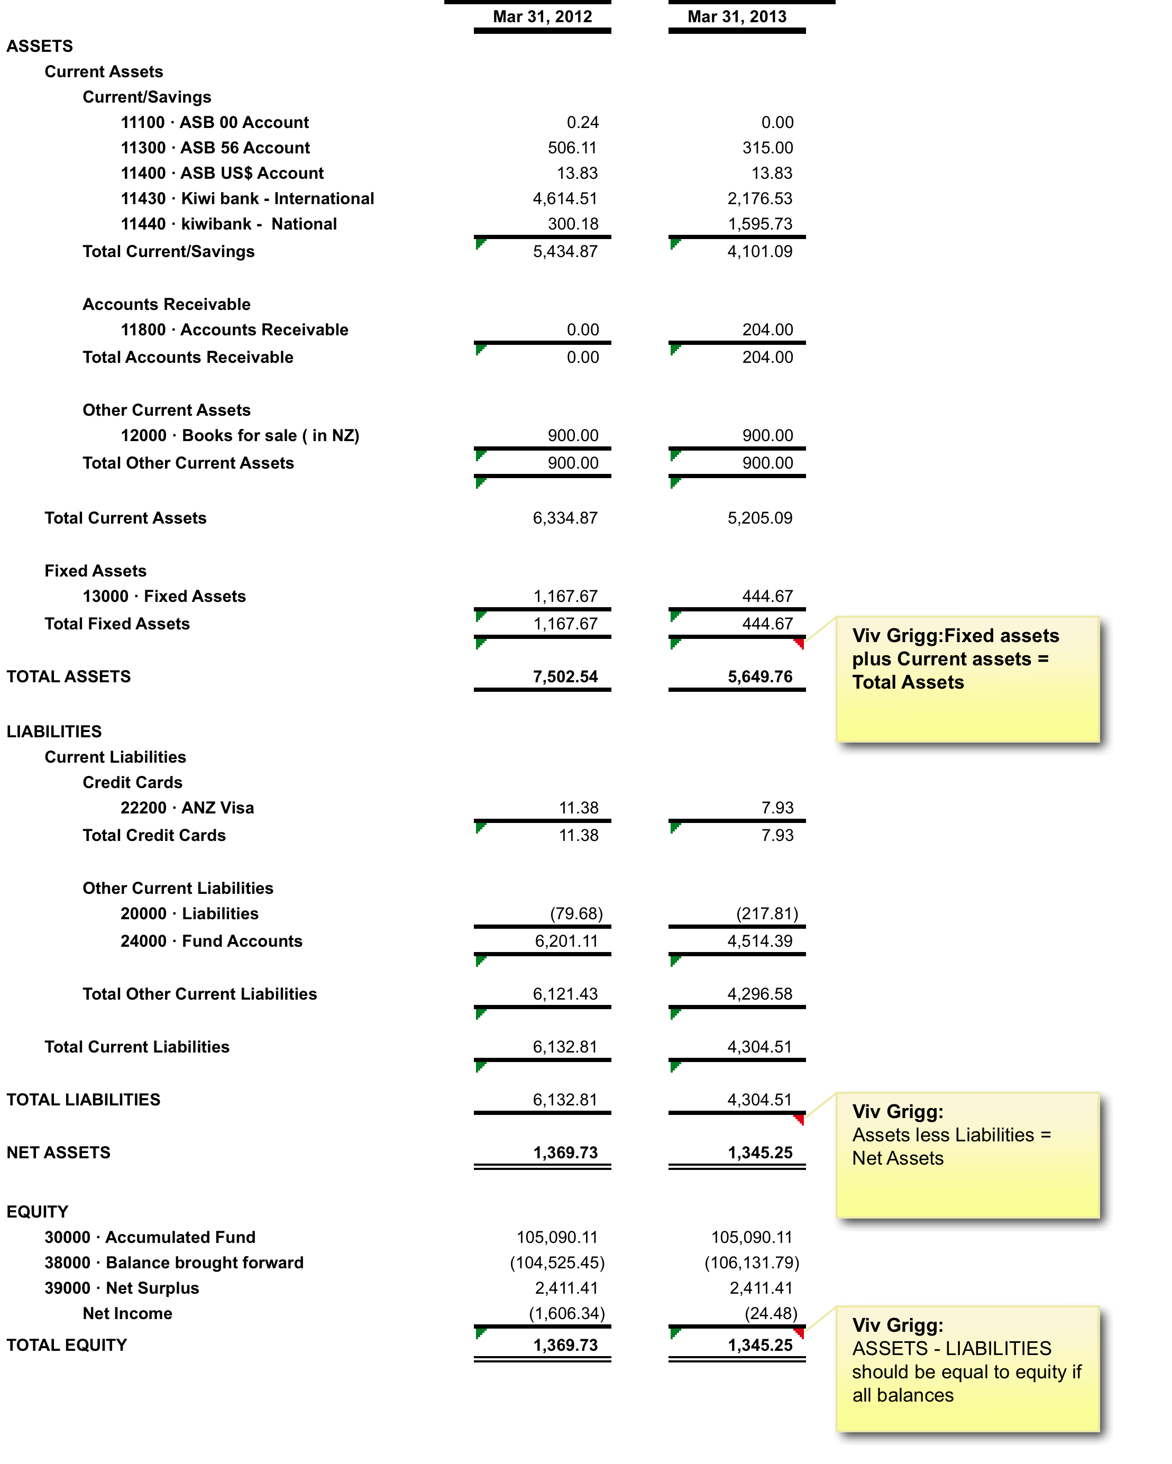
Sample Yearly Balance Sheet
Compare last year with this year
The end of the financial year is usually end of March, June or Sept

Slide 4
Sample Monthly Balance Sheet How is this business doing this month?

Slide 5
Fixed Assets
FIXED ASSETS : These are assets that the business owns. They will keep these assets for several years so they are fixed. Examples: Buildings , Machinery, Vehicles

Slide 6
CURRENT ASSETS
CURRENT ASSETS: These assets will not stay in the business for long. Examples: materials, debtors, money in the bank, petty cash
CURRENT LIABILITIES : The amount of money that a business owes other people and other businesses (creditors). Liabilities are “current” because the amount owed can vary from one day to the next. They must be paid back within a year.

Slide 7
NET ASSETS : NET ASSETS ASSETS minus LIABILITIES (current & fixed) (Current & fixed)
The second section of the balance sheet
This looks at where the money which was used to buy the long term and short term assets came from
The start up of the business is funded by: CAPITAL & RESERVES SHARE CAPITAL – The amount of money paid by shareholders in return for a share in the business.

Slide 8
NET ASSETS : NET ASSETS ASSETS minus LIABILITIES (current & fixed) (Current & fixed)
PROFIT & LOSS ACCOUNT – Net profit from the previous financial year is transferred into the balance sheet.
RETAINED PROFIT – businesses do not give all of their profits back to shareholder
For a non-profti this is called retained income.

Slide 9
Summary
NET ASSETS SHOULD EQUAL THE AMOUNT OF MONEY THAT HAS BEEN INVESTED IN THE BUSINESS. BOTH PARTS OF THE BALANCE SHEET MUST BALANCE
Exercise: ask for last years Balance Sheet ofyour NGO, and seek to understand it.

